Slide 1

Name Badge Task
Lesson 2

Slide 2
Today You Will
Learn how to create your own name badge using a micro:bit
Use the MakeCode website to write a computer program
Understand how to download .hex files to your micro:bit
Notes:
Today leaners will start to develop their first piece of code on the micro:bit to make a name badge. They will also learn how to transfer programs from the PC onto the micro:bit.

Slide 3
The micro:bit
Input devices – allow data to be transferred into the micro:bit
Output devices – show the result of the data having been processed
An LED screen is an example of an output device
Notes:
This initial introduction reminds learners of the concept of input and output devices. You could use questioning prior to showing the slide to see if any learners are able to recall the material covered in the last lesson.

Slide 4
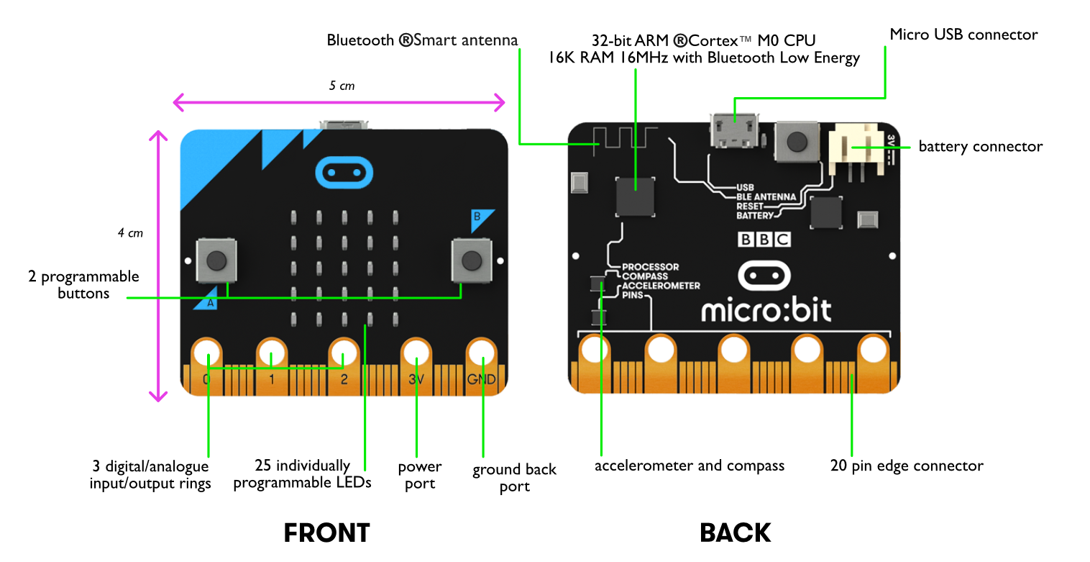
The micro:bit v1 in Detail
Notes:
This builds on the concept of input and output devices. Use the labels to highlight the different components on the micro:bit. The ARM processor acts as the brain of the computer. It processes all instructions from the other components on the device. The accelerometer and compass (magnetometer) are able to automatically detect things and use those readings to input data into the device – these are called sensors. Sensors will be used in future lessons. At this stage it is useful that learners understand that they can be used to generate automatic inputs.

Slide 5
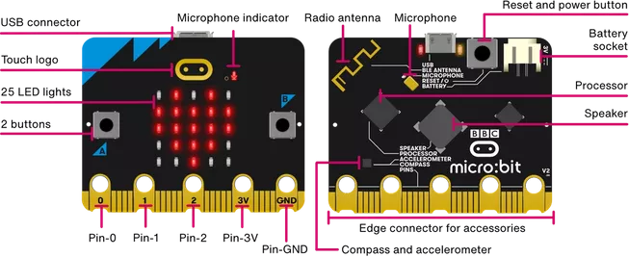
The micro:bit v2 in Detail
Notes:
This builds on the concept of input and output devices. Use the labels to highlight the different components on the micro:bit. The ARM processor acts as the brain of the computer. It processes all instructions from the other components on the device. The accelerometer and compass (magnetometer) are able to automatically detect things and use those readings to input data into the device – these are called sensors. Sensors will be used in future lessons. At this stage it is useful that learners understand that they can be used to generate automatic inputs. Image from: https://microbit.org/get-started/user-guide/overview/

Slide 6
Name Badge Task
You are going to create your own name badge using the micro:bit
Use the instructions to guide you through the task
Once you have created your name badge attempt to complete the Stretch Tasks
Good luck!
Notes:
Learners should then start to program their own name badge. This is the first time that learners will have used the micro:bit in the lesson and they are certain to enjoy the task. The most challenging part of the task will be transferring the hex file from the PC onto the micro:bit. This should initially be demonstrated by the Teacher. It is also worth stressing that all of the blocks are colour coded, which should help learners to find where they are located.
How to Ensure that MakeCode is available
Ensure the following website are unfiltered (a constantly updated list is available at https://support.microbit.org/support/solutions/articles/19000030385-firewall-whitelist-requirements-for-micro-bit-editors)
You need access to USB devices if these are blocked by default all Micro:bits use the same ID – use your security policy to exempt the micro:bit ID
PXT / MakeCode/Javascript Blocks Editor:
pxt.microbit.org
makecode.microbit.org
makecode.com www.pxt.io trg-microbit.userpxt.io pxt.azureedge.net
github.com Blocks:
www.microbit.co.uk
Touch Develop:
www.microbit.co.uk
Code Kingdoms:
www.microbit.co.uk
microbit.codekingdoms.com
Python Web Editor (microbit.co.uk)
www.microbit.co.uk
Python Web Editor (microbit.org)
python.microbit.org

